Slide 1
Git and JUnit
Integration with Jenkins

Slide 2
Contents
Definition of Terms
Introduction to Junit
Features of JUnit
Pre-Requisites
Integrating JUnit Application with Jenkins
Integrating Git with Jenkins

Slide 3
Definition of Terms
Jenkins
Jenkins is an award-winning, cross-platform, continuous integration and continuous delivery application.
Jenkins is an open source automation server written in Java
Use Jenkins to build and test your software projects continuously making it easier for developers to integrate changes to the project, and making it easier for users to obtain a fresh build.
It also allows you to continuously deliver your software by providing powerful ways to define your build pipelines and integrating with a large number of testing and deployment technologies.

Slide 4
Definition of Terms
Git
Git is a version control system (VCS) for tracking changes in computer files and coordinating work on those files among people.
Testing
Testing is the process of checking the functionality of an application to ensure it runs as per requirements

Slide 5
Definition of Terms
Unit Testing
Is the testing of single entity (class or method)
Unit testing can be done in two ways − manual testing and automated testing
Manual Testing | Automated Testing
Executing a test cases manually without any tool support is known as manual testing. | Taking tool support and executing the test cases by using an automation tool is known as automation testing.
Time-consuming and tedious − Since test cases are executed by human resources, it is very slow and tedious. | Fast − Automation runs test cases significantly faster than human resources.
Huge investment in human resources − As test cases need to be executed manually, more testers are required in manual testing. | Less investment in human resources − Test cases are executed using automation tools, so less number of testers are required in automation testing.
Less reliable − Manual testing is less reliable, as it has to account for human errors. | More reliable − Automation tests are precise and reliable.
Non-programmable − No programming can be done to write sophisticated tests to fetch hidden information. | Programmable − Testers can program sophisticated tests to bring out hidden information.

Slide 6
Introduction to JUnit
JUnit is a unit testing framework for the Java programming language.
JUnit has been important in the development of test-driven development, and is one of a family of unit testing frameworks which is collectively known as xUnit that originated with SUnit.
JUnit is a simple framework to write repeatable tests
JUnit is linked as a JAR at compile-time
A research survey performed in 2013 across 10,000 Java projects hosted on GitHub found that JUnit was the most commonly included external library

Slide 7
Introduction to JUnit
JUnit promotes the idea of "first testing then coding", which emphasizes on setting up the test data for a piece of code that can be tested first and then implemented. This approach is like "test a little, code a little, test a little, code a little." It increases the productivity of the programmer and the stability of program code, which in turn reduces the stress on the programmer and the time spent on debugging.

Slide 8
Features of JUnit
JUnit is an open source framework, which is used for writing and running tests.
JUnit tests allow you to write codes faster, which increases quality.
JUnit is elegantly simple. It is less complex and takes less time.
JUnit tests can be run automatically and they check their own results and provide immediate feedback. There's no need to manually comb through a report of test results.
JUnit shows test progress in a bar that is green if the test is running smoothly, and it turns red when a test fails.

Slide 9
Pre-Requisites
Jenkins installed locally
Git installed locally
Maven installed locally
JUnit Application
GitHub account and repository

Slide 10
Jenkins Installation
Go to this link https://jenkins.io
Download the Windows Installer. This will download a zip file containing an MSI (Microsoft Installer) file.
Unzip the file, then run the installer. Once the installation is complete, open your browser.
On the URL, open this link http://localhost:8080
It will open the Jenkins Server. When prompted for configuration, choose the recommended. You will have to wait for its plugins to be installed before you can access the dashboard.
Also, for you to access is, you need to enter the initialAdminPassword. After that, you can create your own account and delegate it as an admin.

Slide 11
Git Installation
Go to this link https://git-scm.com/downloads
Click the download link for windows.
The download will start automatically. Once the download is done, run the git executable.
Choose the default options until the installation is complete. Once done, try to open Git Bash
This is the terminal that we’re going to use in order for us to communicate with GitHub

Slide 12
Maven Installation
Go to this link https://maven.apache.org/download.cgi
In the files section, download the binary zip archive
Once the download is over, unzip the file inside a folder
Set the maven’s environment variable on your local machine
This will allow us to invoke Maven commands without always specifying the location of the Maven Executable.
Open a Command Prompt. Then type this command. mvn –version

Slide 13
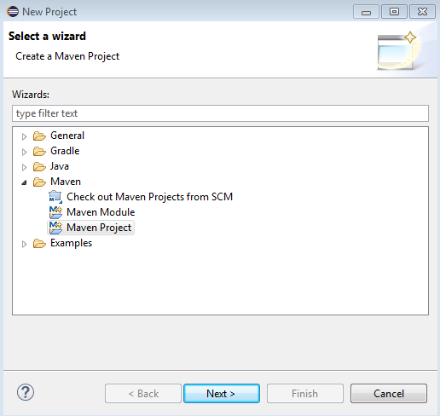
Create a JUnit Application
Download junit.jar
Open Eclipse
Click File > New > Project > Select Maven Project

Slide 14
Create a JUnit Application
3. Open pom.xml and include the Junit dependency
4. Run Test

Slide 15
Demonstration
Integrating Git with Jenkins
Integrating JUnit with Jenkins

